Slide 1
Effects of Oscillatory Plunging Motion on an Airfoil Near Stall
Sponsor: U.S. Air Force Office of Scientific Research (FA9550-14-1-0184)
Ray Pitts¹
Dr. Jesse Little²
University of Arizona, Tucson, AZ
Arizona Space Grant Statewide Symposium
Tempe, Arizona, April 22nd, 2017
¹Undergraduate Student
²Associate Professor
Notes:
List me as an associate prof---share this with marcos and colin
Make sure to point out sponsor
Good morning,
Mark agate
Graduate student at UA studying aerospace engineering

Slide 2
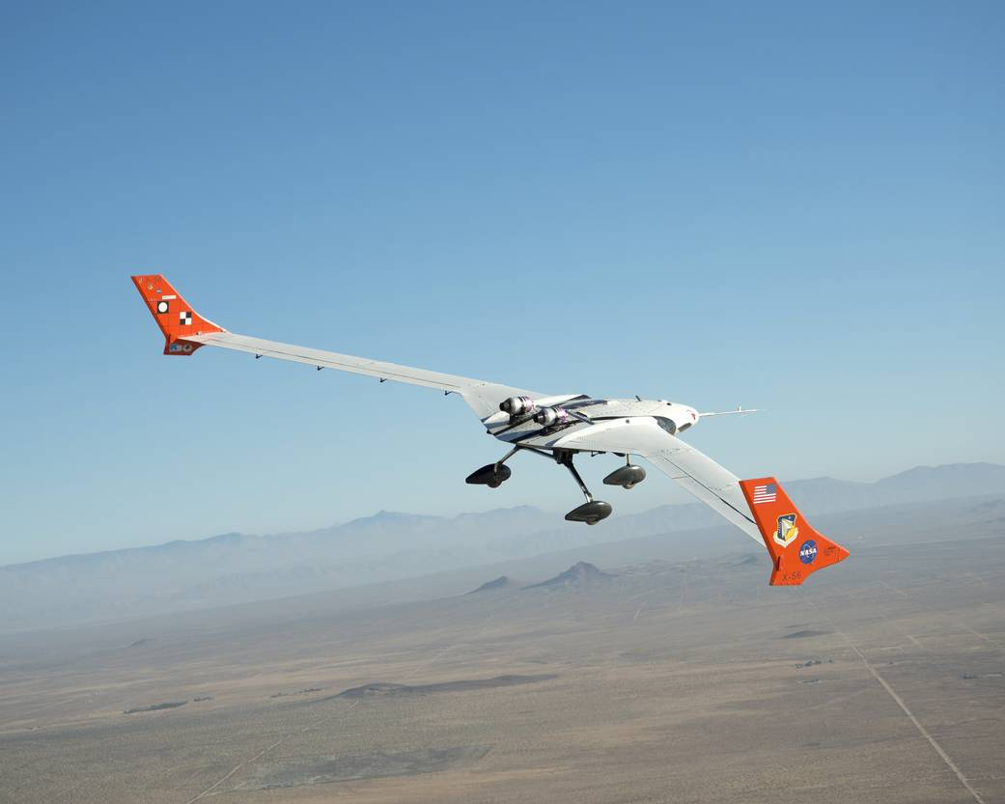
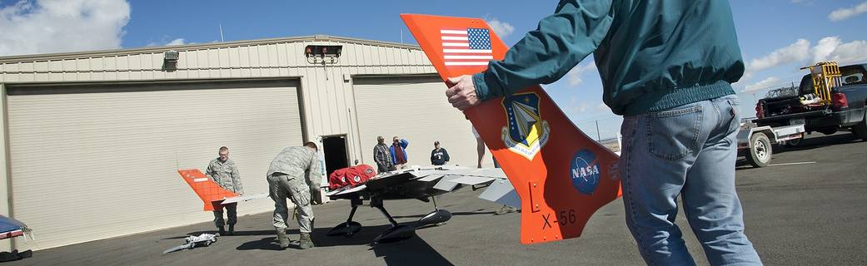
Background and Motivation
[1]
Aviation industry is moving towards composite materials
Carbon based wing structures allow for higher aspect ratio wings that are more flexible
Notes:
Carbon fiber is stronger and lighter compared to standard aluminum construction and has almost no fatigue issues
Carbon based wing structures allow for higher aspect ratio wings that are more flexible. This can also be seen on remote piloted UAVs such as the X-56 shown on the right.
These more flexible structures can then experience increased structural motion in flight.
Structural motion causes significantly different lift characteristics
X-56A designed to be a flutter test bed, also is an excellent test bed for low amplitude, high frequency vibrations
Modular design to allow for different configurations for testing

Slide 3
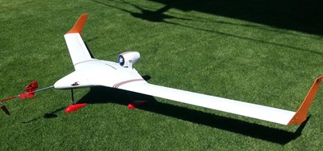
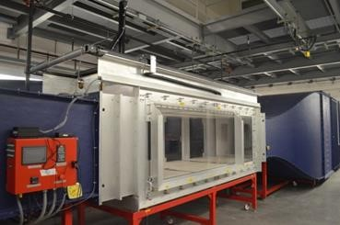
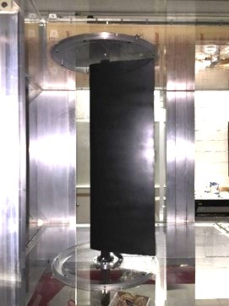
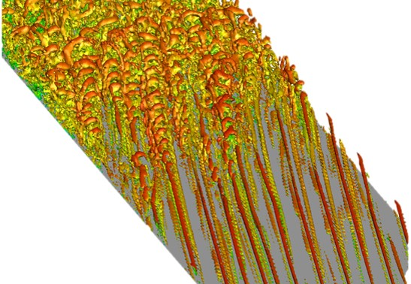
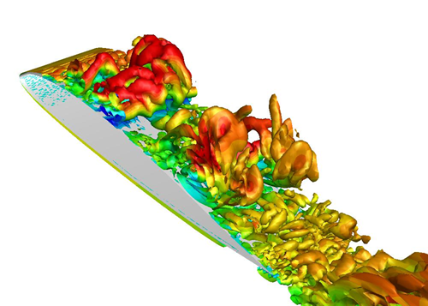
Multi-Dimensional Research Approach
X-56A 1/3 scale
X56A: 1/3 scale
Scientifically instrumented scaled flight experiments
Wind tunnel experiments
Simulations & Theory & Experiments
Modal decomposition (Fourier, POD, DMD)
Linear Stability Theory, etc.
Detailed simulations of flow physics for relevant model problems
Simulations for entire wing sections undergoing typical structural motion
Notes:
Be sure to point out your focus
SH
A combined investigative approach which employs high-fidelity numerical simulations, wind & water-tunnel and free-flight experiments all grounded in theory is taken to investigate and understand the fundamental flow physics of separation and separation control for wing sections undergoing temporal motions. This multi-tiered approach allows for the cross-validation of the different investigative tools (free-flight & wind-tunnel experiments, simulations) and thus increases chances for breakthroughs in this difficult field of research.
Combined approach
Two flight test models
Subsonic wind tunnel testing
CFD simulations

Slide 4

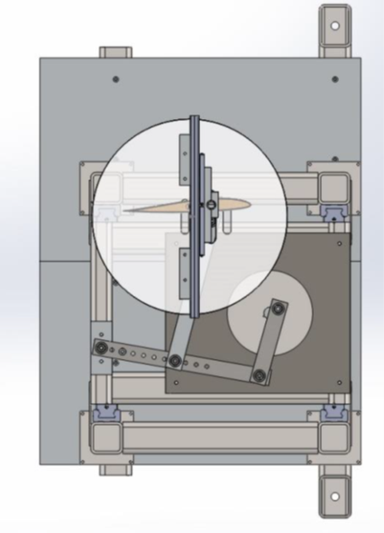
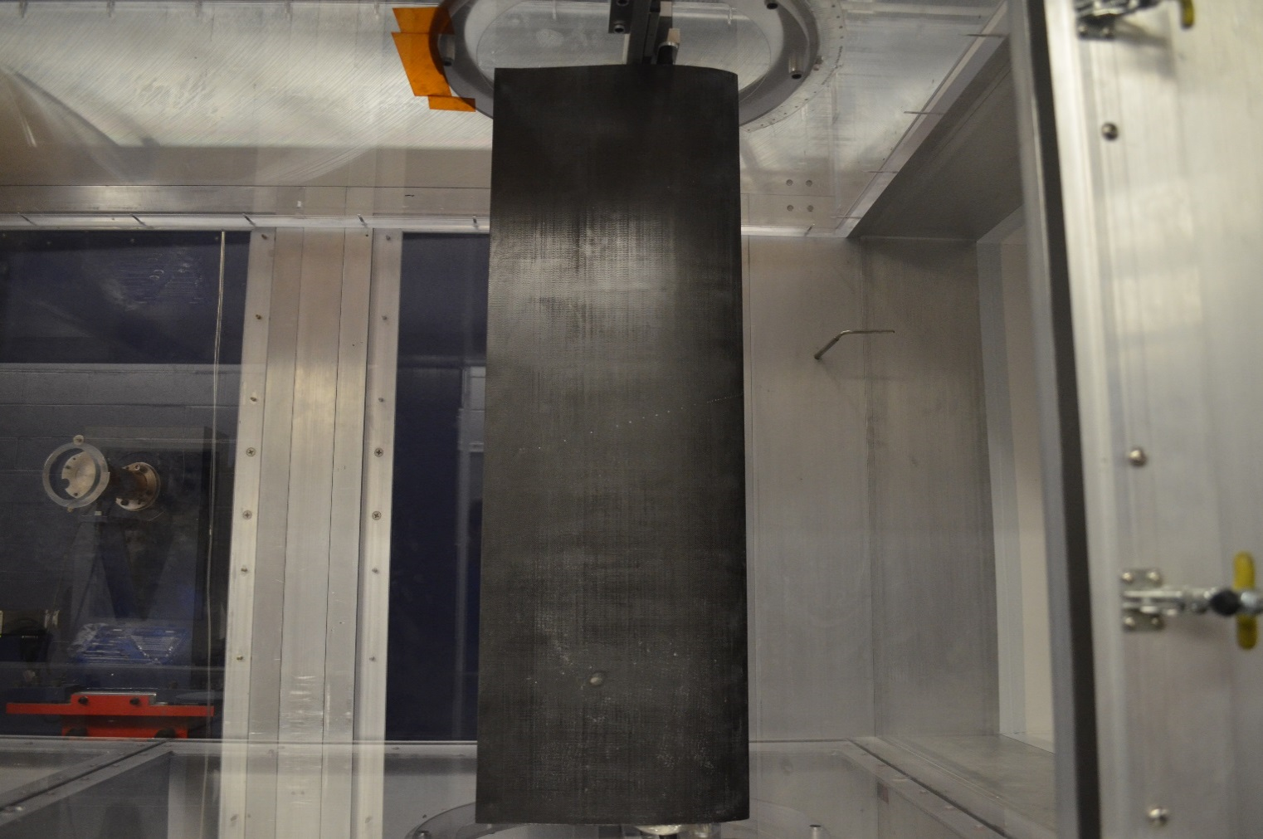
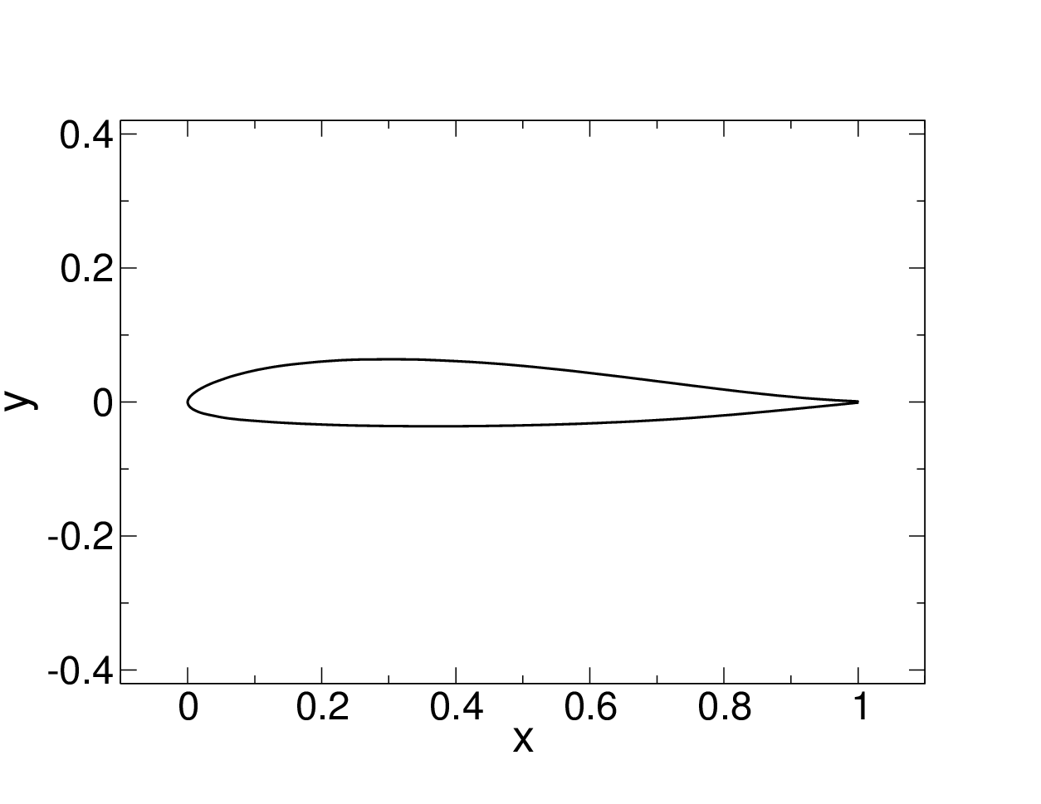
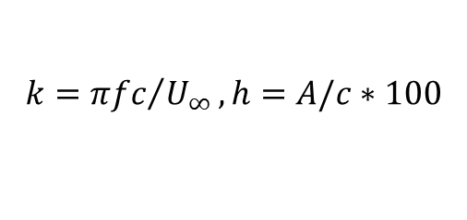

Wind Tunnel Experiments
3ft x 4ft x 12ft subsonic wind tunnel, 1ft chord X-56A airfoil
$k$ selected as it is close to the eigenfrequency of the scaled model (8 Hz)
Re = 200,000 (11 m/s)
$α=10°, k=0.7, h=3.2\%$
$α=14°, k=0.7, h=4.8\%$
$$k={πfc}/{U_{∞}}, h=A/c∗100$$
X-56A
Notes:
Need to define k and h
Subsonic wind tunnel testing
Re=200,000 is minimum flight Re or near-stall conditions
Motion is perpendicular to chord
Eigen frequency of wing is the same as the half-scale flight model
64 Pressure taps in order to make calculations
Talk about motion how revolutions of the motor are translated into linear motion from the tlop of the stroke to the bottom of the stroke and back to the top.

Slide 5
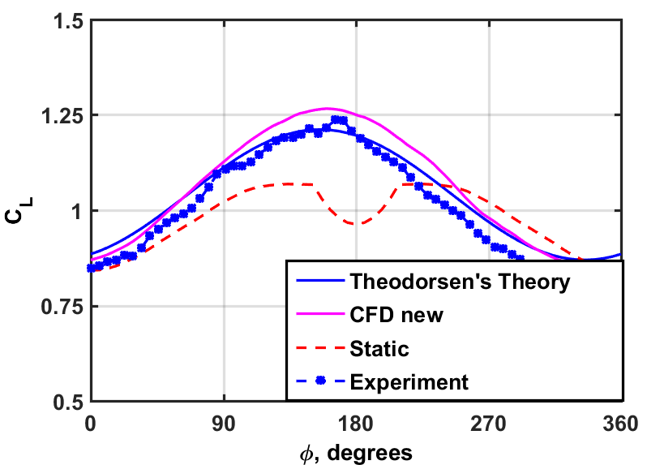
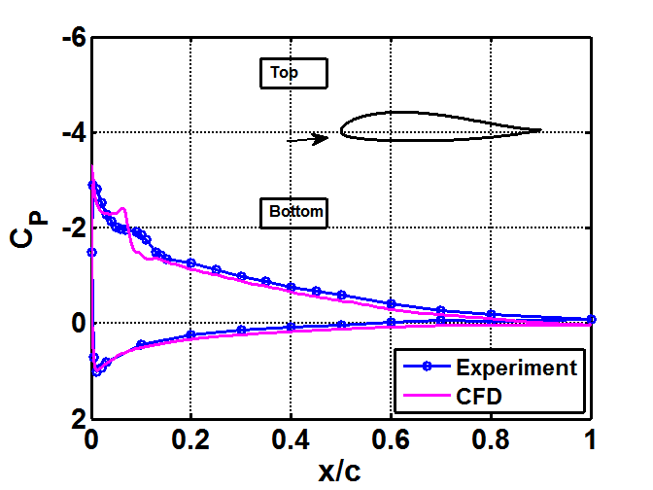
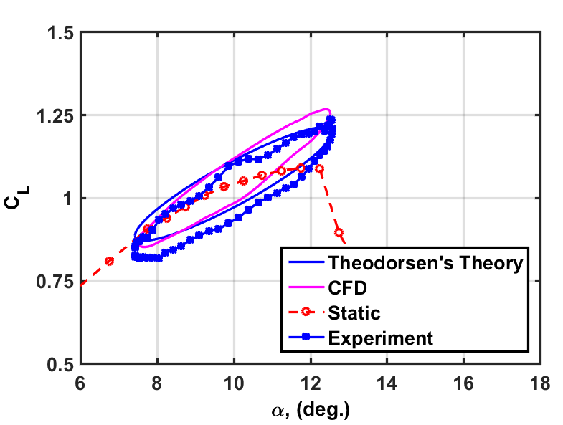

Plunging Airfoil: $α=10°, k=0.7, h=3.2\%$
C_{L} oscillations follow prediction based on Theodorsen
LSB has minimal growth and does not shed
Figures from ref. [2]
Notes:
Make sure you are comfortable with all of this. Is the CL data updated based on recent convos with Andreas?
Good agreement between Exp, CFD, and theory
Sinusoidal shape as reflected in unsteady lift
Bubble has minimal growth and does not “shed
CP gif explanation: shows growing and shrinking of LSB as larger alphas make LSB grow,m no shedding behavior here and LSB decreases the pressure increasing lift.

Slide 6
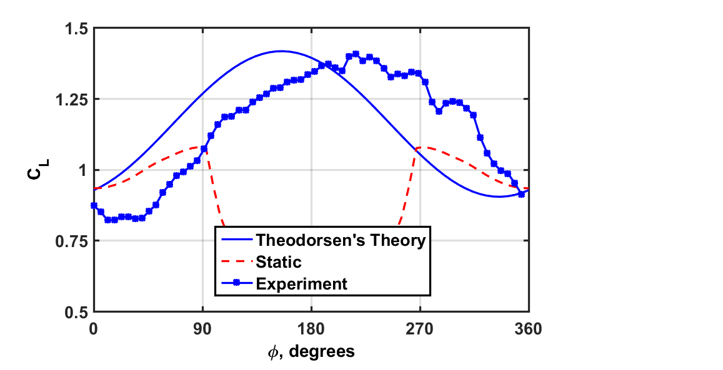
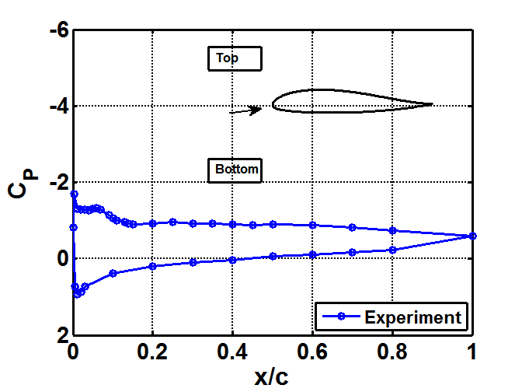
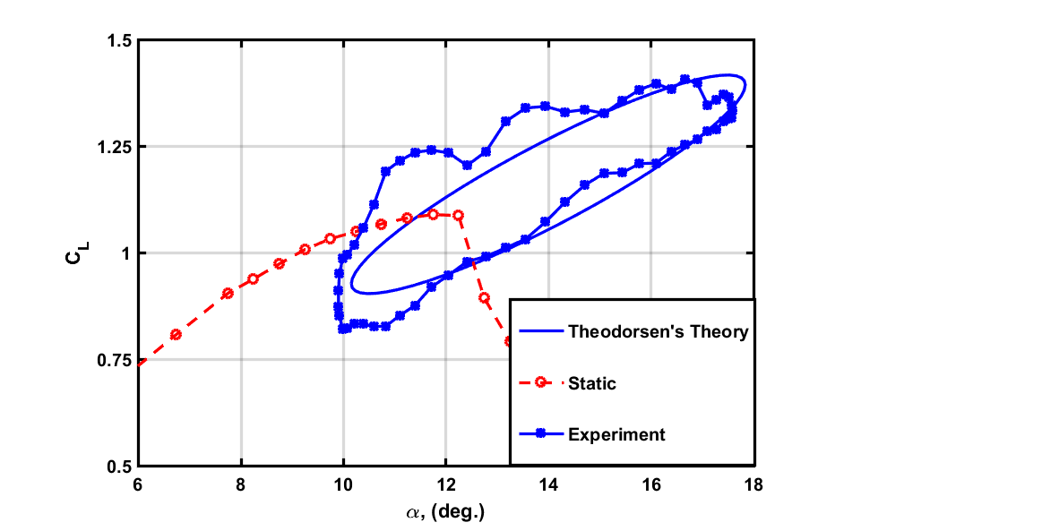

Plunging Airfoil: $α=14°, k=0.7, h=4.8\%$
Experiment has now diverged from CFD
Large phase difference with Theodorsen’s Theory
Longer attachment and growth of laminar separation bubble
Figures from ref. [2]
Notes:
Mention that this creates moment stall when you present (even if we are not showing it)
14 degree case important as this AoA is relevant during takeoff and landing. CL vs phi shows no lift stall compared static and from CL vs AoA experimental ranges far from theodorsens so cannot use Theodorsens to compare. Shedding of LSB from LE shows the movement of pressure distribution. This movement in pressure distribution moves the location where lift occurs at. Accordingly, As the lift acts further down the chord, the moment shifts from pitch up to pitch down, making for undersibale flight.
Nice rolling behavior of LSB
NO CLEAR LIFT STALL

Slide 7
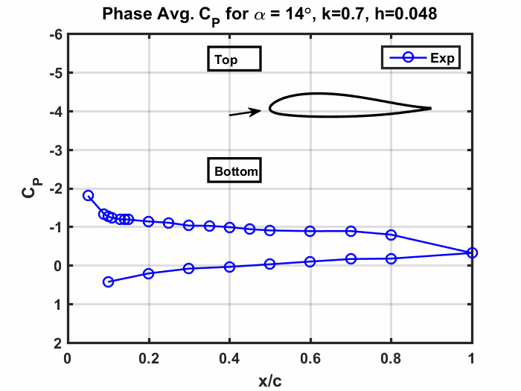
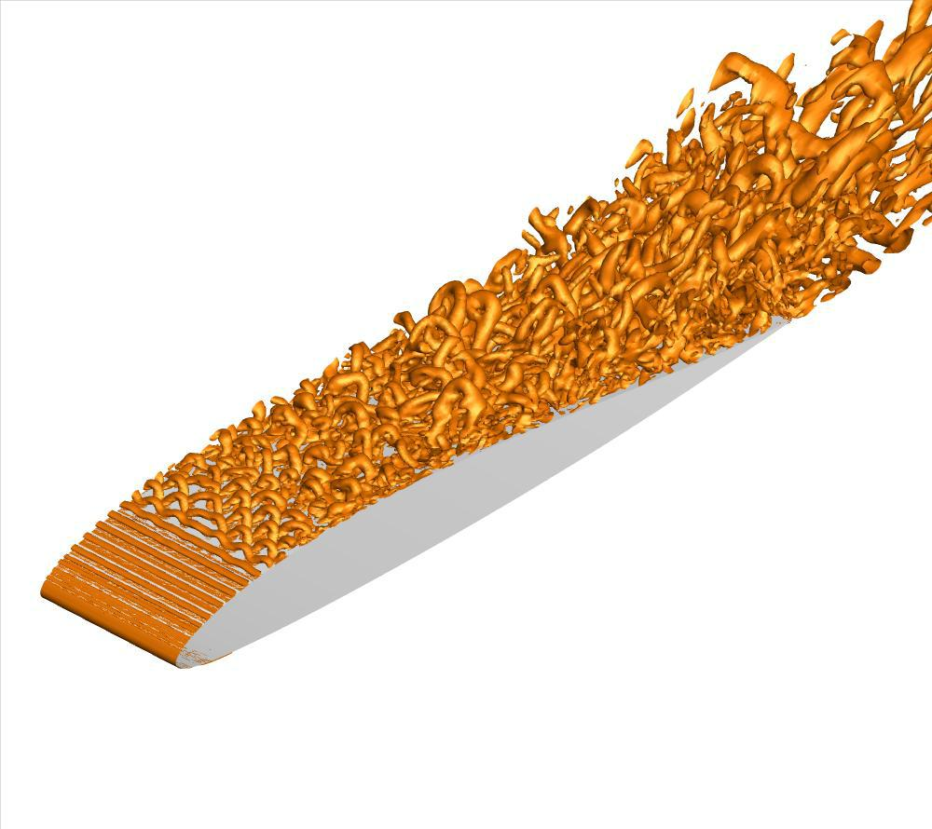
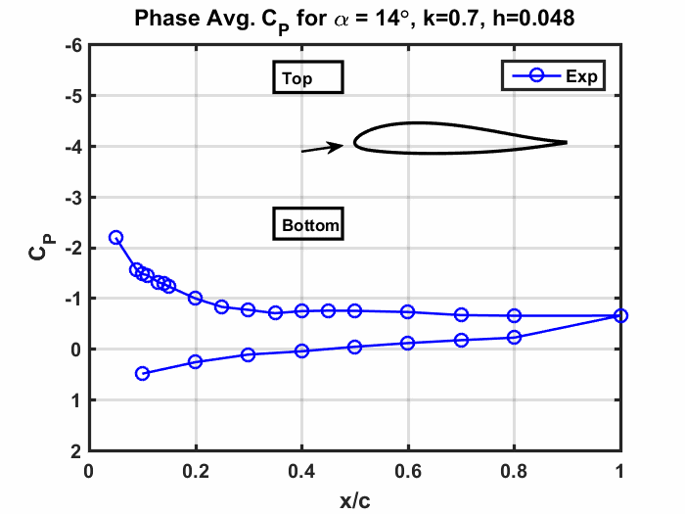

Flow Control: $α=14°, k=0.7, h=4.8\%$
AFC off
(Gross 2017) [3]
AFC on
Plasma actuator used to reduce separation
Forcing excites the LSB allowing the flow to remain attached
Future work needed to clarify the experimental mechanism
Notes:
These plots were given to me by Christopher with the labels as they are.
Would be good to clean them up so that they resemble previous versions. Also want to describe a little bit about the flow control.
The key is that the bubble is being affected, but it is not necessarily just a trip since it doesn’t happen with plasma off. Need more investigation to clarify. It would be good to include a picture from andreas since we are going to try to measure similar things. I will send.

Slide 8
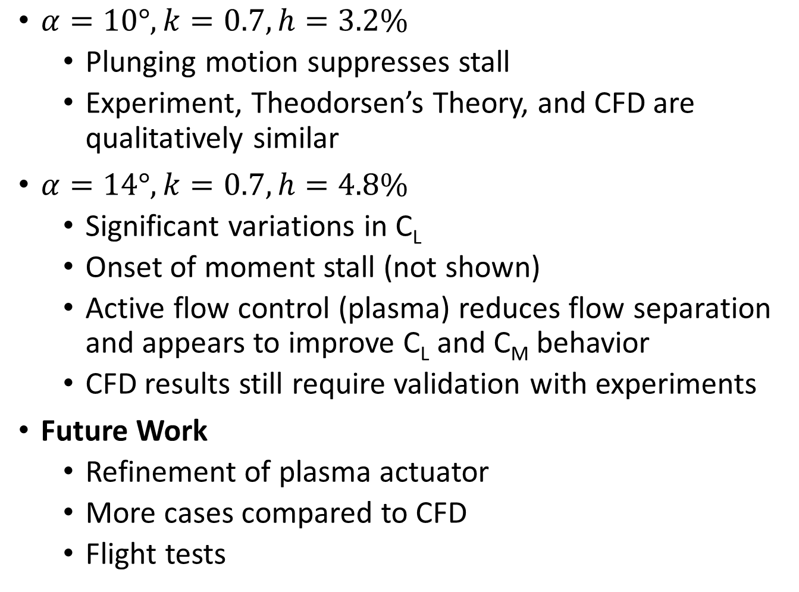
Conclusions
$α=10°, k=0.7, h=3.2\%$
Plunging motion suppresses stall
Experiment, Theodorsen’s Theory, and CFD are qualitatively similar
$α=14°, k=0.7, h=4.8\%$
Significant variations in C_{L}
Onset of moment stall (not shown)
Active flow control (plasma) reduces flow separation and appears to improve C_{L} and C_{M} behavior
CFD results still require validation with experiments
Future Work
Refinement of plasma actuator
More cases compared to CFD
Flight tests
Notes:
You can mention 12 here if you like. The problem with 14 is moment stall. Ask mark about this.
The good part about the controlling the bubble is we don’t get a strong pitch break.
Also many more measurements for future work. do we see what andreas sees?
10 degree validates experimental setup

Slide 9
Acknowledgments
Mark Agate, Graduate Student, the University of Arizona
Christopher Otto, Graduate Student, the University of Arizona
Dr. Kevin Bao, the University of Arizona
The Department of Aerospace and Mechanical Engineering at the University of Arizona
The University of Arizona Aerospace and Mechanical Engineering Machine Shop (Dale Drew, Lane Hammond, and Joe Hartley)
Arizona-NASA Space Grant Consortium
AFOSR
Notes:
I would just put these names on small print on title stlide

Slide 10
Questions?

Slide 11
References
[1]: Gross, A., Little, J., and Fasel, H., “Numerical Simulation of Wing Section Near Stall," AIAA, unpublished.
[2]: LockheedMartin, “X-56A - Lockheed Martin," 2015, 18 Dec. 2015.
[3]: Agate, M., Pineda, S., Pitts, R., Little, J., Fasel, H., Gross, A. (2017). SciTech 2017: Effect of Oscillatory Plunging Motion on Airfoil boundary Layer and Wake Behavior. Grapevine, TX. Unpublished.

Slide 12
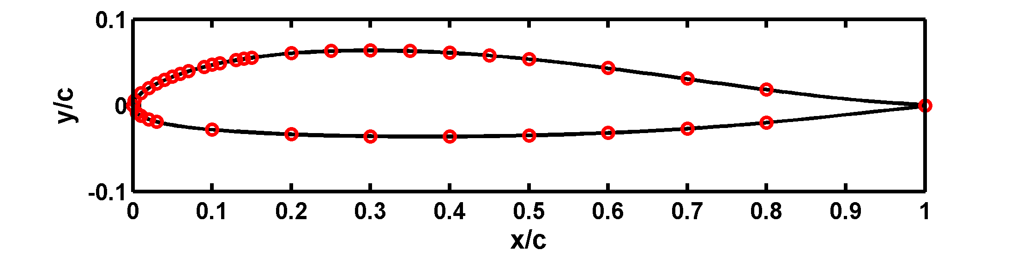
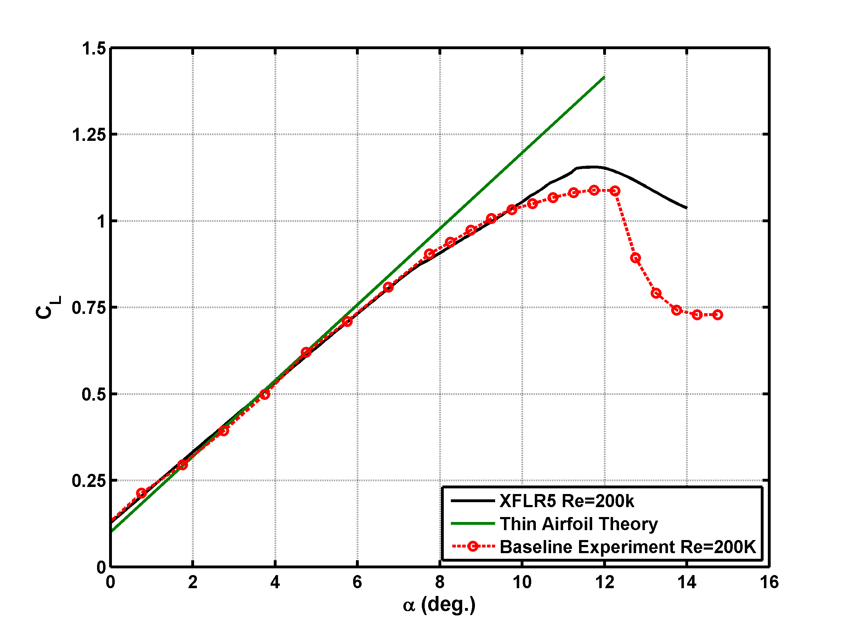
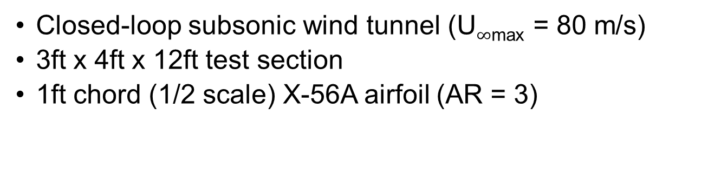
Wind Tunnel Experiments
Closed-loop subsonic wind tunnel (U$∞$_{max} = 80 m/s)
3ft x 4ft x 12ft test section
1ft chord (1/2 scale) X-56A airfoil (AR = 3)
Notes:
The wind tunnel experiments that will be presented were conducted at the U of A’s new closed-loop subsonic wind tunnel.
The wind tunnel has a maximum free stream velocity of 80 m/s and 3ft x 4ft x 12 ft test section.
The airfoil model built has a 1ft chord ( of ½ scale of the X-56 airfoil) and has an aspect ratio of 3
The airfoil profile can be seen here, and the model was constructed in house. It is constructed out of carbon fiber for future surface heating/ IR camera experiments.
The airfoil is also mounted vertically and instrumented with 64 pressure taps

Slide 13
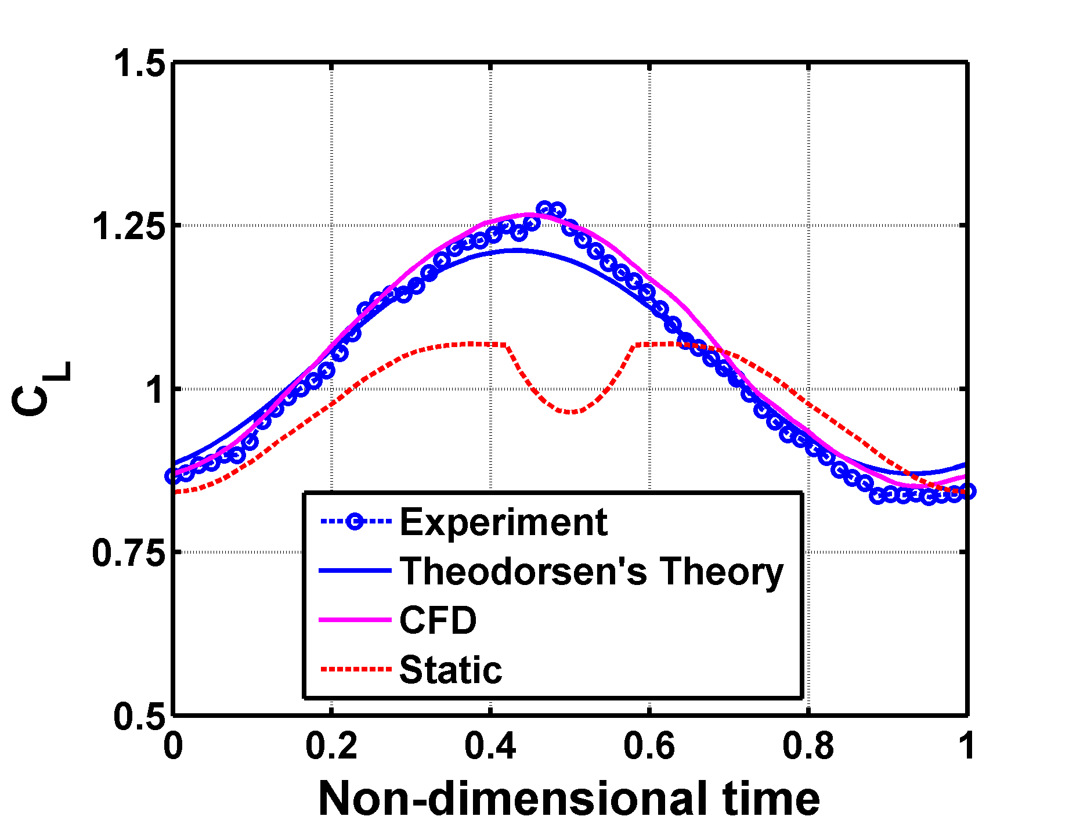
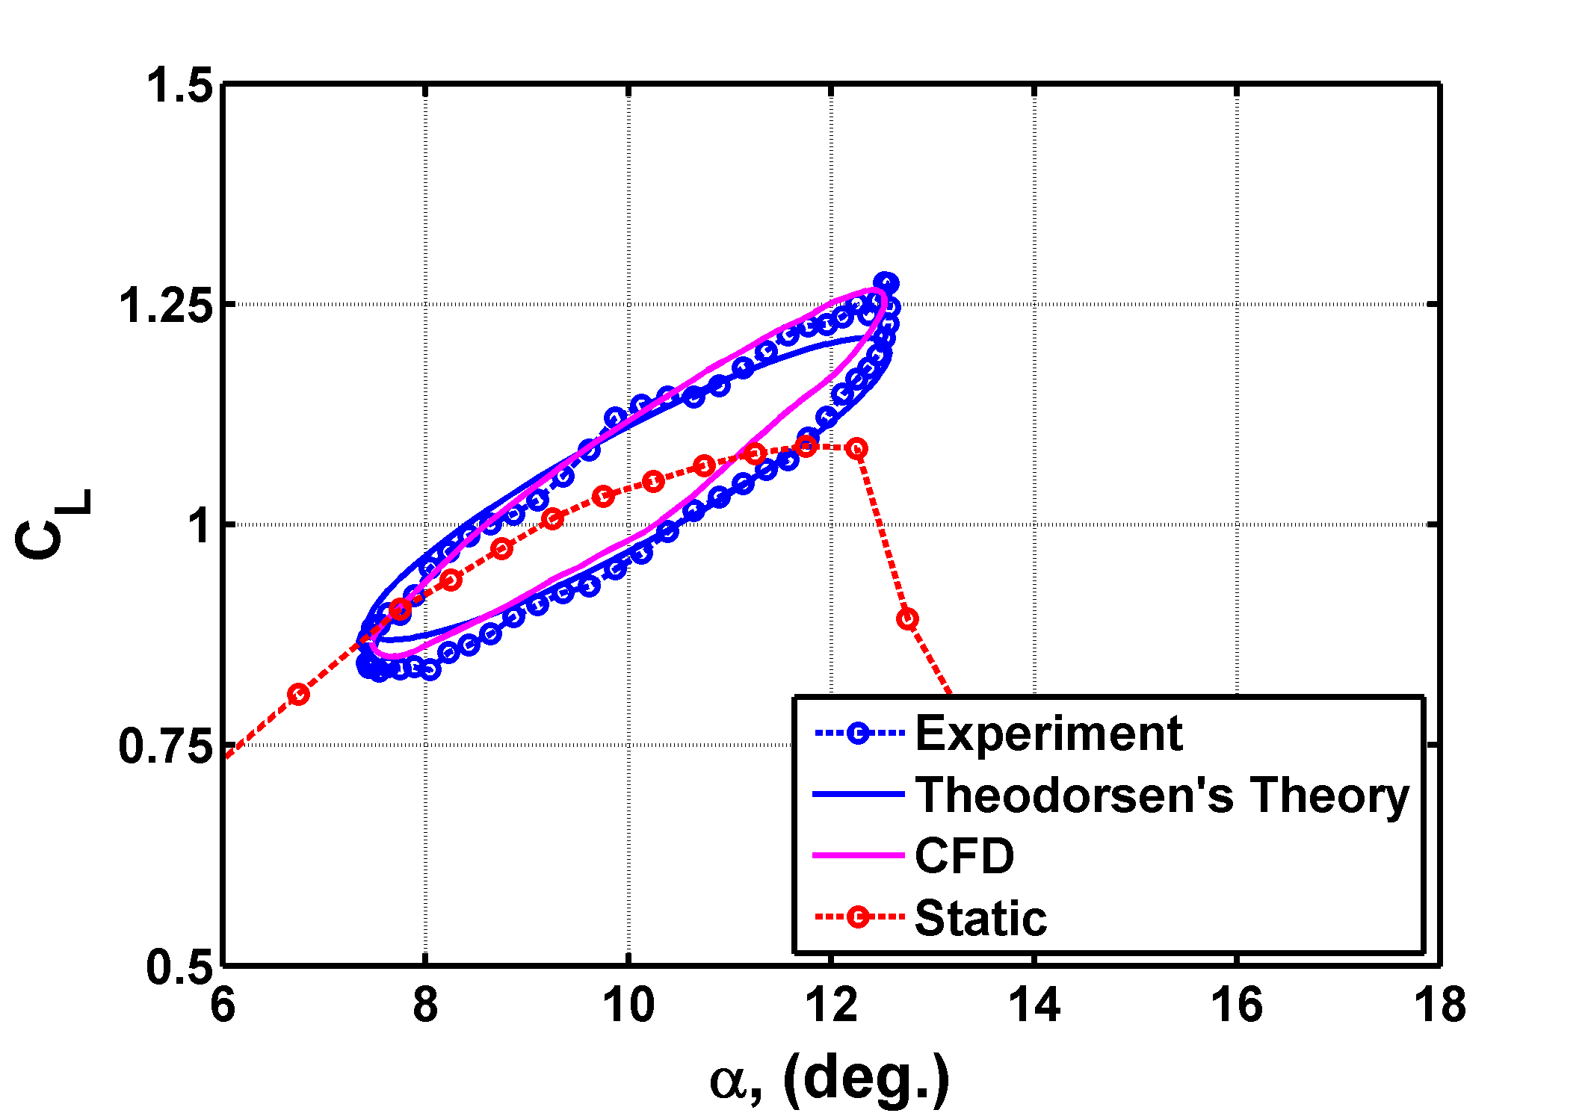

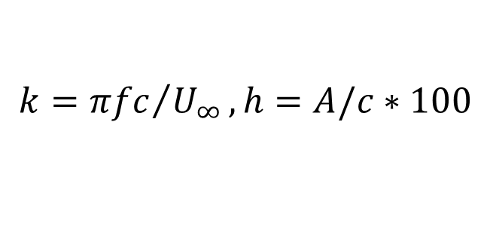
Plunging Airfoil: $α=10°, k=0.70, h=3.2\%$
$$k={πfc}/{U_{∞}}, h=A/c∗100$$
C_{L} oscillations follow prediction based on Theodorsen
Laminar LE bubble transitions followed by an attached turbulent BL
Suction side BL and wake are modulated by plunging motion
Notes:
CFD shows the laminar separation bubble is small and no significant shedding
Gif is interpolated data, should not go out of phase. Movie will always be out of phase

Slide 14
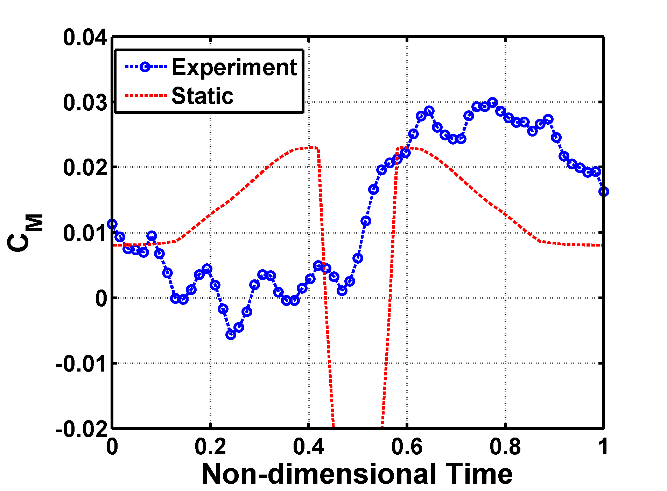
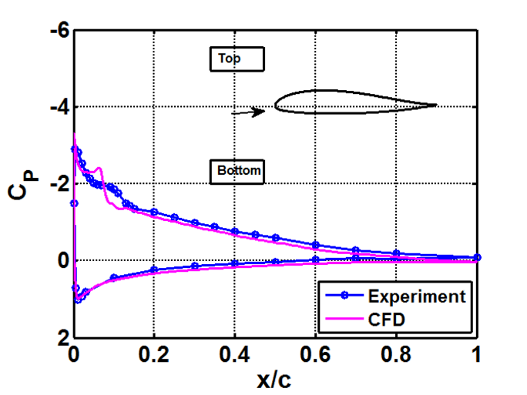
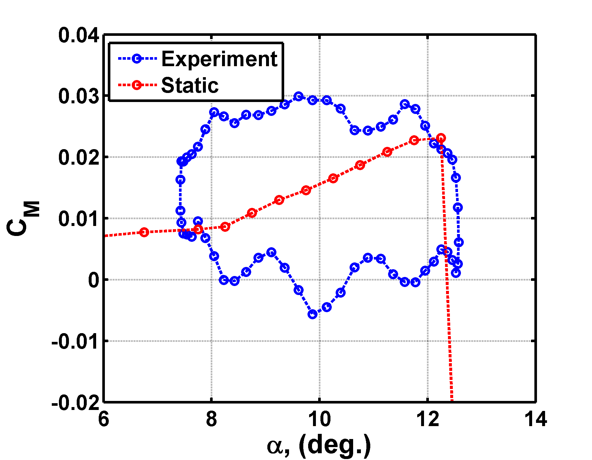
Plunging Airfoil: $α=10°, k=0.70, h=3.2\%$
$$k={πfc}/{U_{∞}}, h=A/c∗100$$
Moment oscillates with plunging cycle
No clear moment stall for oscillation case
Positive moment for nearly all of the oscillation cycle
Notes:
Good agreement between Exp, CFD, and theory
Sinusoidal shape as reflected in unsteady lift
Bubble has minimal growth and does not “shed”

Slide 15
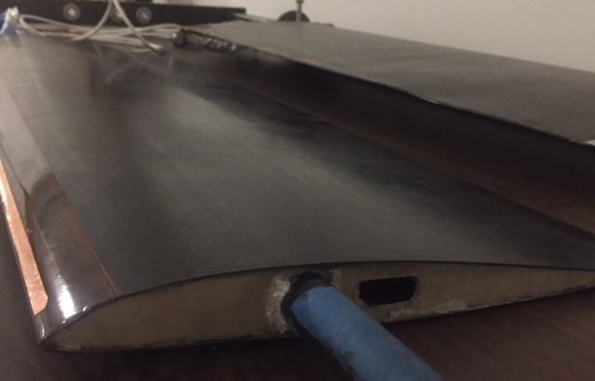
Actuator

Slide 16
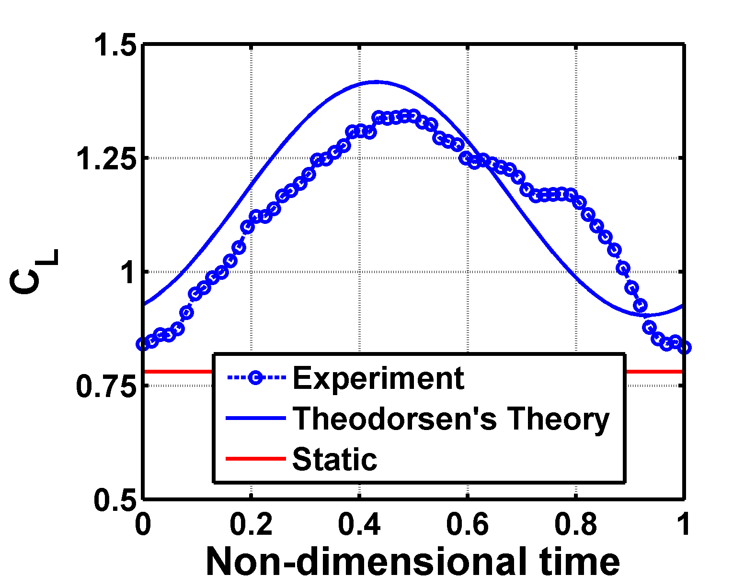
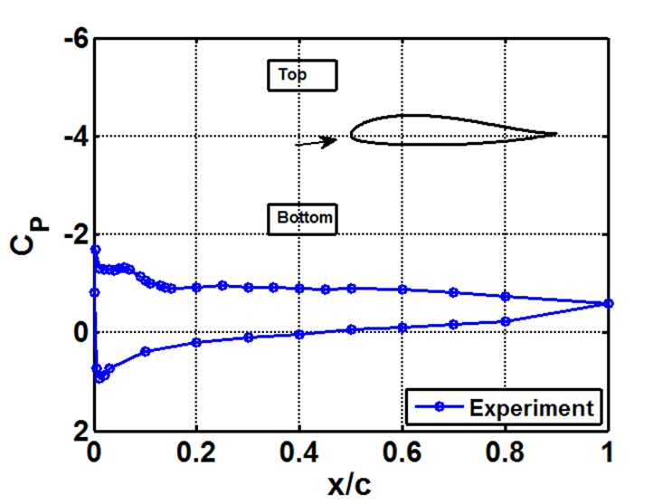
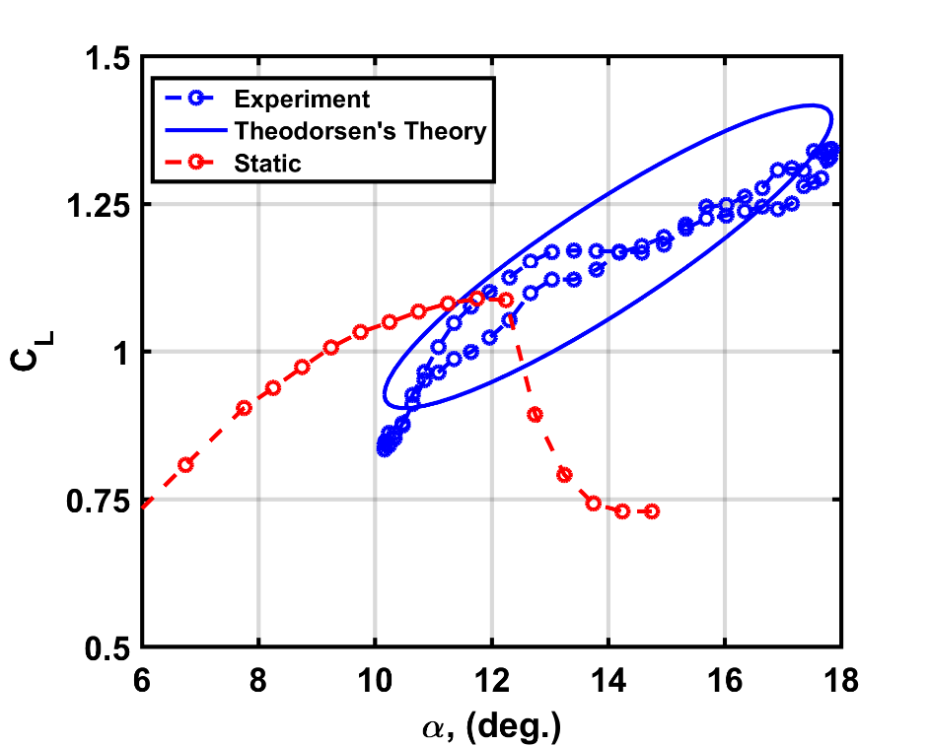
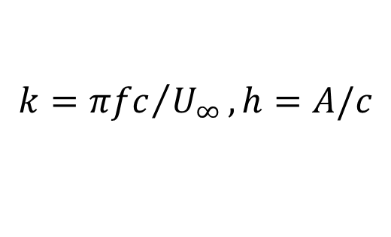

Plunging Airfoil: $α=14°, k=0.7, h=0.048$
$$k={πfc}/{U_{∞}}, h=A/c$$
Experiment has now diverged from CFD
Large phase difference with Theodorsen’s Theory
Longer attachment and growth of laminar separation bubble
Notes:
Large deviation between CFD and experiments, currently diagnosing
Shape is not sinusoidal
Much higher lift than the static case
Theodorsen’s incorrectly predicts phase shift
Much more significicant vortex shedding on the airfoil
Large bubble growth
Flow is staying attached into a deep stall

Slide 17
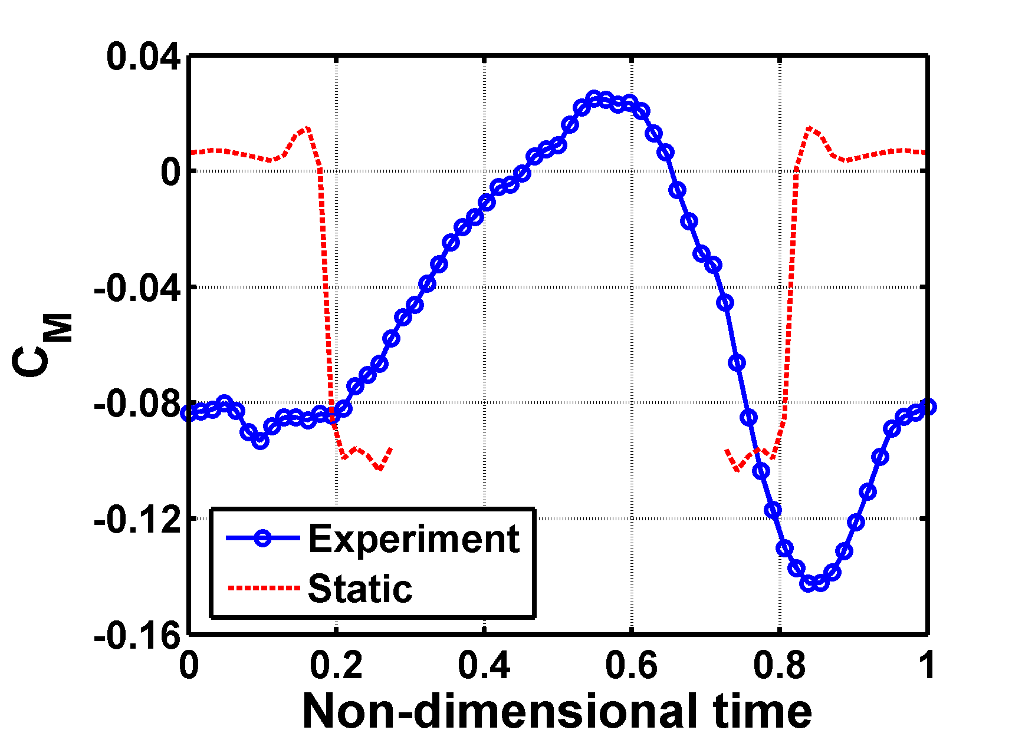
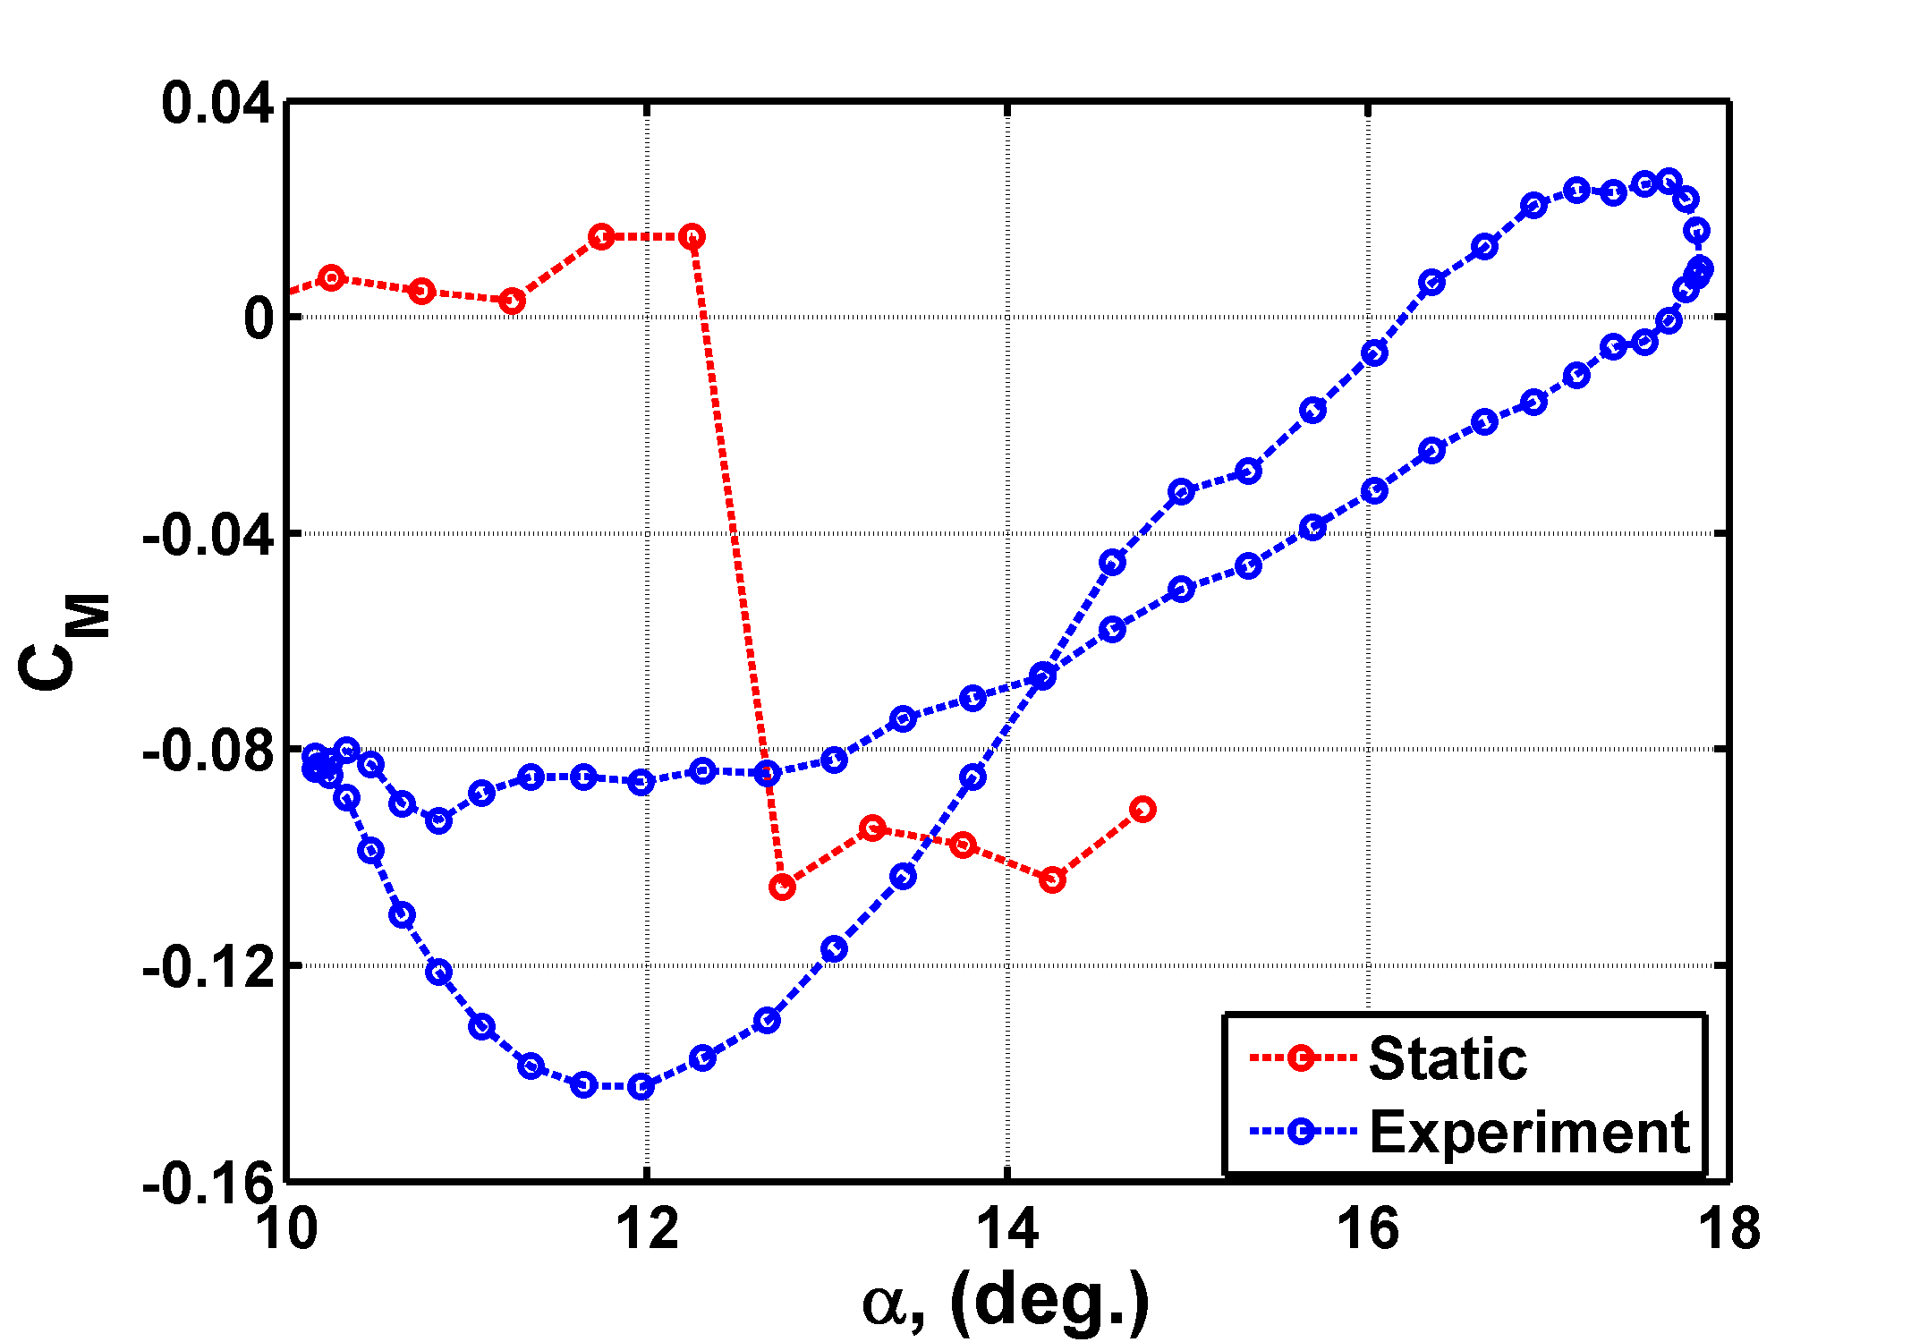
Plunging Airfoil: $α=14°, k=0.7, h=0.048$
$$k={πfc}/{U_{∞}}, h=A/c$$
Drastically different moment from static case
Due to LSB “bursting”
Notes:
Large deviation between CFD and experiments, currently diagnosing
Shape is not sinusoidal
Much higher lift than the static case
Theodorsen’s incorrectly predicts phase shift
Much more significicant vortex shedding on the airfoil
Large bubble growth
Flow is staying attached into a deep stall

Slide 18
Old Plots

Slide 19
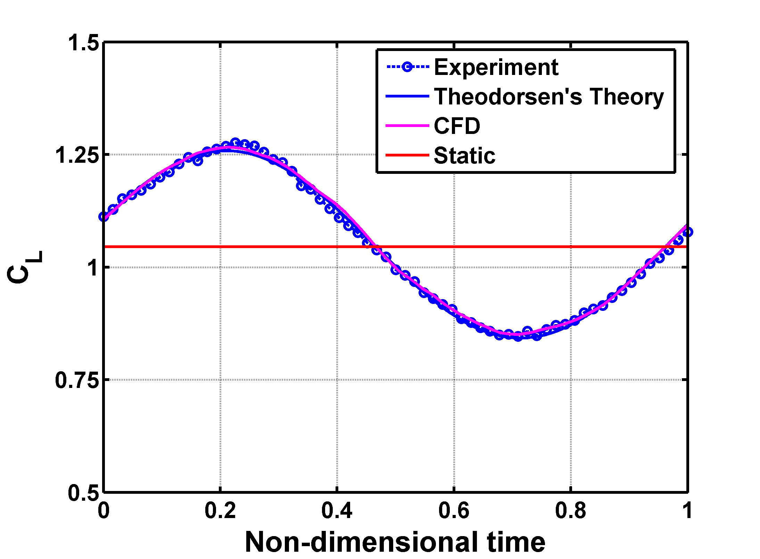
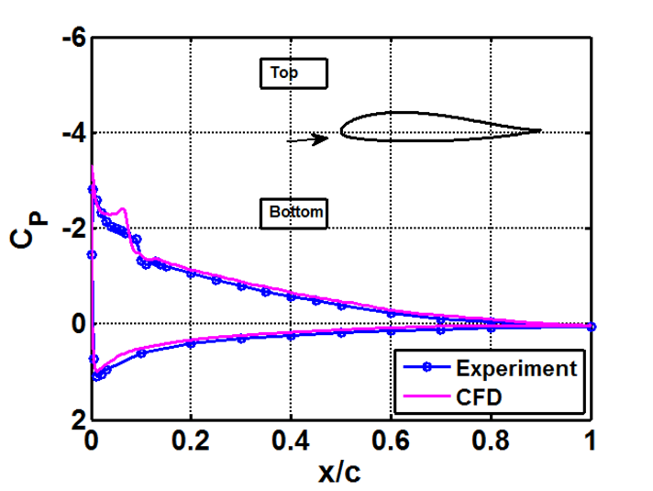
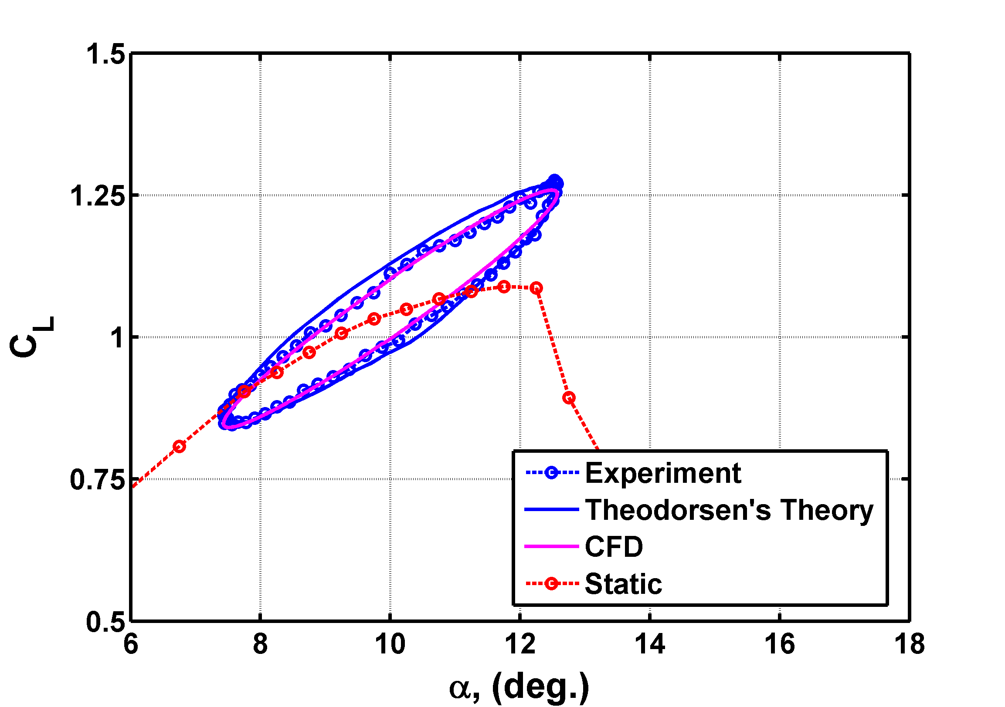

Plunging Airfoil: $α=10°, k=0.70, h=0.032$
$$k={πfc}/{U_{∞}}, h=A/c$$
C_{L} oscillations follow prediction based on Theodorsen
Laminar LE bubble trips flow to turbulence followed by an attached turbulent BL
Suction side BL and wake are modulated by plunging motion
Notes:
Good agreement between Exp, CFD, and theory
Sinusoidal shape as reflected in unsteady lift
Bubble has minimal growth and does not “shed”

Slide 20
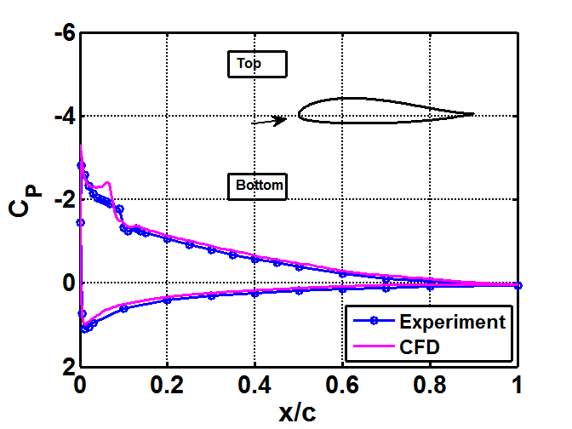
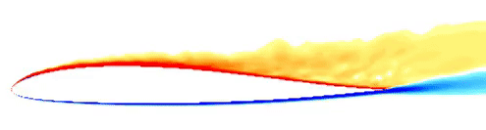
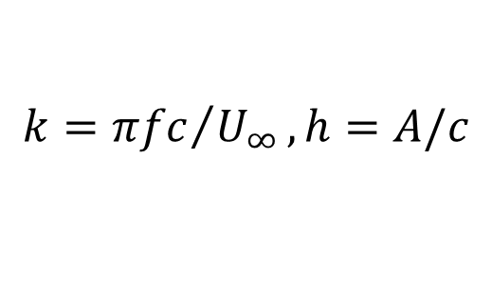
Plunging Airfoil: $α=10°, k=0.70, h=0.032$
$$k={πfc}/{U_{∞}}, h=A/c$$
C_{L} oscillations follow prediction based on Theodorsen
Laminar LE bubble trips flow to turbulence followed by an attached turbulent BL
Suction side BL and wake are modulated by plunging motion
Notes:
CFD shows the laminar separation bubble is small and no significant shedding
Gif is interpolated data, should not go out of phase. Movie will always be out of phase

Slide 21
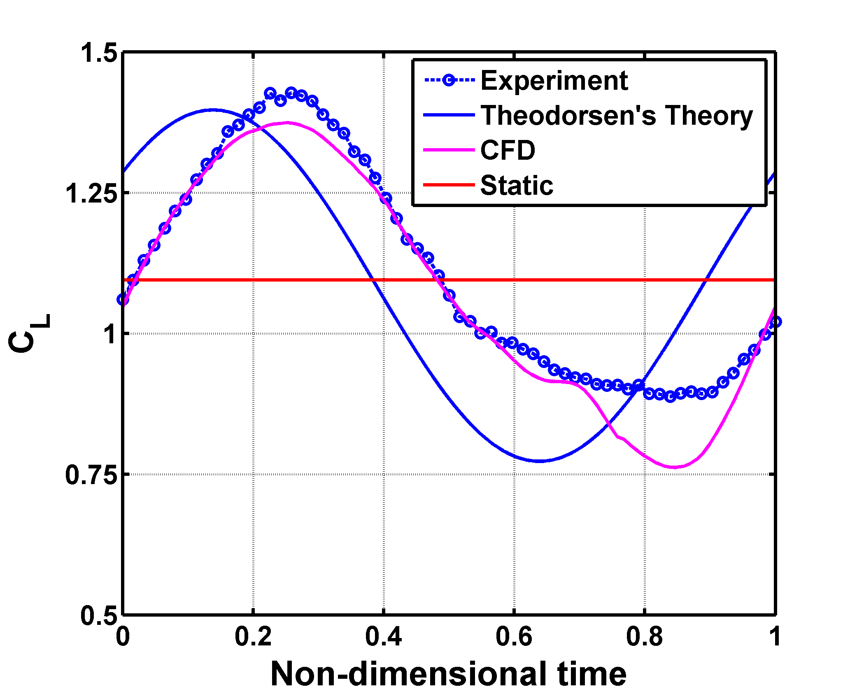
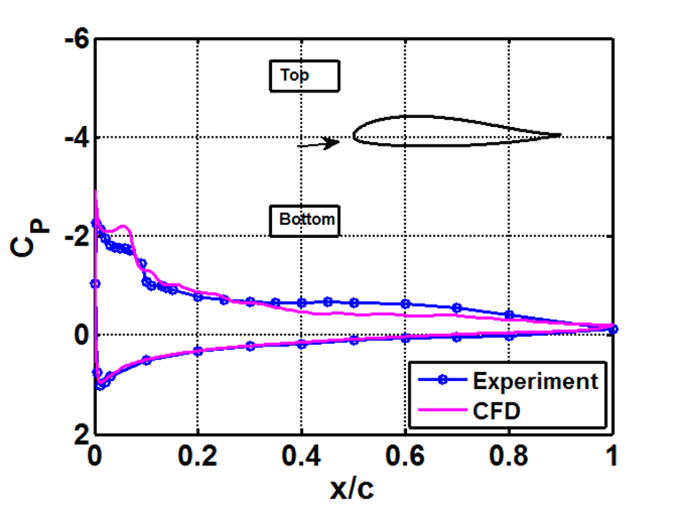
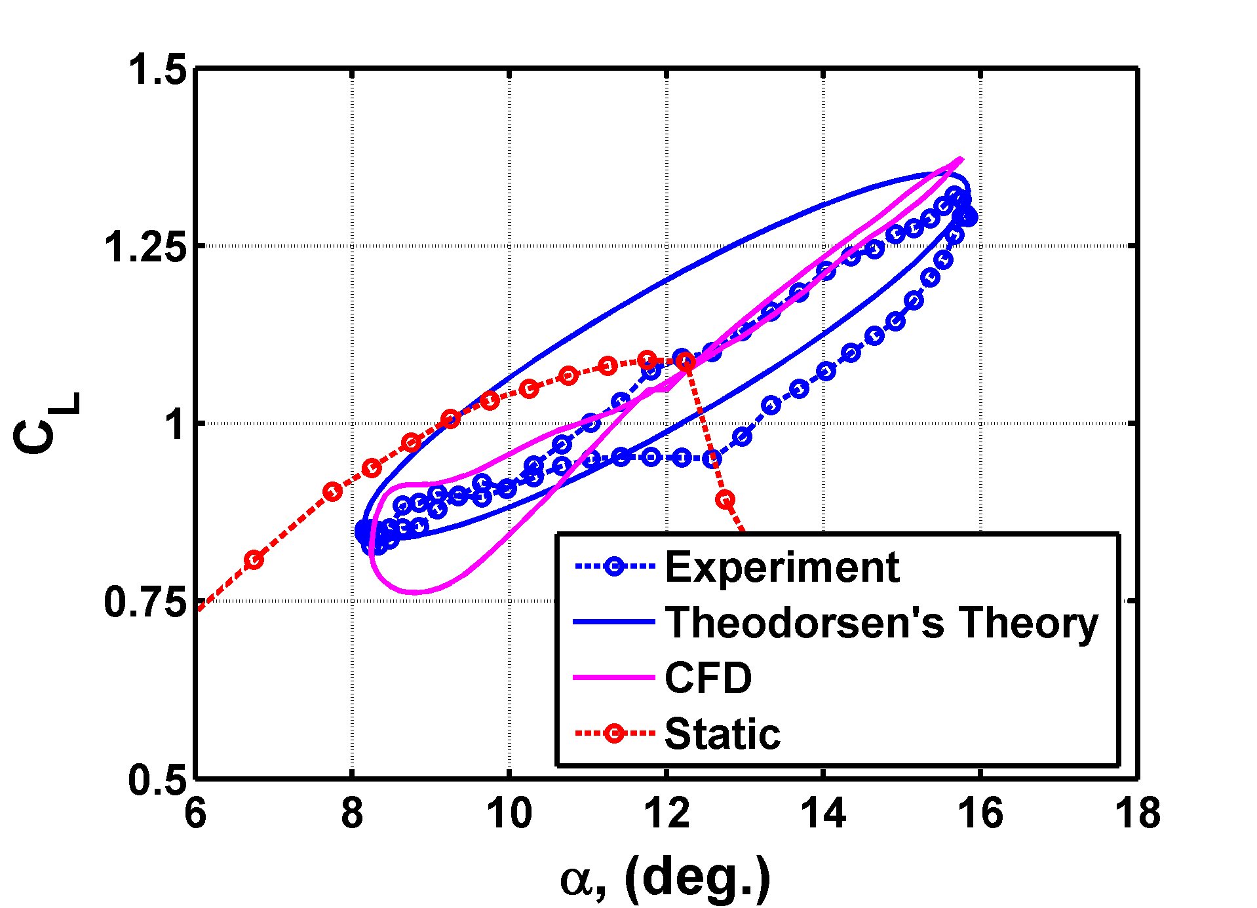
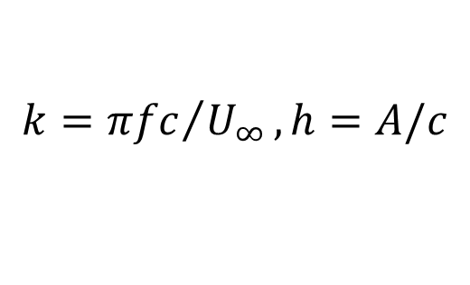
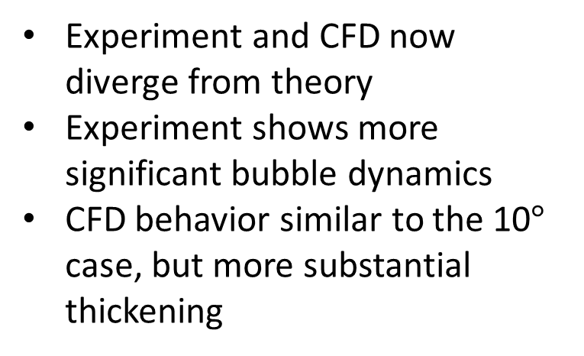

Plunging Airfoil: $α=12°, k=0.7, h=0.048$
$$k={πfc}/{U_{∞}}, h=A/c$$
Experiment and CFD now diverge from theory
Experiment shows more significant bubble dynamics
CFD behavior similar to the 10$°$ case, but more substantial thickening
Notes:
Lift greatly passes into the static stall regime
Bubble has significant growth
Sheds off the back of the airfoil
No longer sinusoidal
Significant phase shift as theodorsen’s does not account for stall
CFD is showing slightly different bubble characteristics, could be due to the resolution of the simulation or the sampling resolution of the experiments, working towards resolving this issue

Slide 22
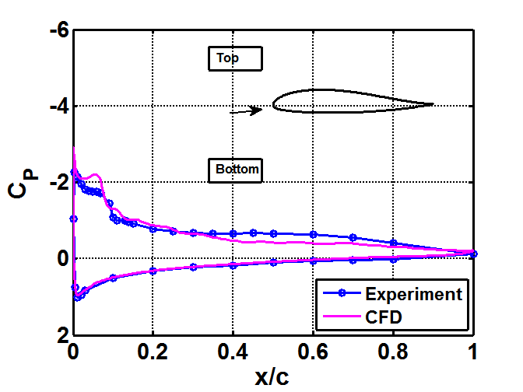


Plunging Airfoil: $α=12°, k=0.7, h=0.048$
$$k={πfc}/{U_{∞}}, h=A/c$$
Experiment and CFD now diverge from theory
Experiment shows more significant bubble dynamics
CFD behavior similar to the 10$°$ case, but more substantial thickening
Notes:
CFD agreeing with significant bubble growth and vortex shedding
Vortex sheds off the back of the airfoil
Gif is interpolated data, should not go out of phase. Movie will always be out of phase

Slide 23
Nominal Static Plots

Slide 24




Plunging Airfoil: $α=10°, k=0.70, h=0.032$
$$k={πfc}/{U_{∞}}, h=A/c$$
C_{L} oscillations follow prediction based on Theodorsen
Laminar LE bubble trips flow to turbulence followed by an attached turbulent BL
Suction side BL and wake are modulated by plunging motion
Notes:
Good agreement between Exp, CFD, and theory
Sinusoidal shape as reflected in unsteady lift
Bubble has minimal growth and does not “shed”

Slide 25

Plunging Airfoil: $α=12°, k=0.7, h=0.048$
$$k={πfc}/{U_{∞}}, h=A/c$$
Experiment and CFD now diverge from theory
Experiment shows more significant bubble dynamics
CFD behavior similar to the 10$°$ case, but more substantial thickening
Notes:
Lift greatly passes into the static stall regime
Bubble has significant growth
Sheds off the back of the airfoil
No longer sinusoidal
Significant phase shift as theodorsen’s does not account for stall
CFD is showing slightly different bubble characteristics, could be due to the resolution of the simulation or the sampling resolution of the experiments, working towards resolving this issue

Slide 26




Plunging Airfoil: $α=12°, k=0.7, h=0.048$
$$k={πfc}/{U_{∞}}, h=A/c$$
Moment changing due to “bursting” of LSB
Clear moment stall compared to 10$°$ case
Significant effect on aircraft flight characteristics
Notes:
CM is neg or near zero for a portion of the oscillation cycle
Parameters could be tuned for beneficial CM
Moemnt stall occurs before lift stall

Slide 27
The effects of small amplitude (0.030<A/c<0.048) high frequency (0.61<πfc/U∞<0.70) plunging motion of the X-56A airfoil are examined at Re=200,000 for three angles of attack. Two angles of attack were chosen at pre-stall conditions and one angle of attack was selected to study post-stall effects. Static stall of the airfoil is 12.25∘ and the examined angles are 10∘, 12∘, and 14∘. The purpose of this research is to examine the aerodynamic influence of structural motion when the wing is vibrating close to its eigenfrequency near static stall. The aerodynamic characteristics generated by the plunging motion are considered with specific focus on the laminar separation bubble near the leading edge. For the cases examined, the static lift is greatly exceeded. At the plunging case of 10∘ angle of attack, experimental results are very similar to those obtained from Theodorsen's Theory. For the 12∘ plunging case, lift exceeds that predicted by Theodorsen's Theory and the leading edge bubble bursts during the oscillation cycle. At the static stall condition of 14∘, plunging periodically reattaches the flow and the bubble bursting is much more significant.

Slide 28

Background and Motivation
Images: https://upload.wikimedia.org/wikipedia/commons/0/0a/Boeing_787_first_flight.jpg & http://www.nasa.gov/sites/default/files/thumbnails/image/ed15-0241-21.jpg
Aviation industry is moving towards composite materials
Compared to aluminum, carbon is stronger and lighter with almost no fatigue issues
Carbon based wing structures allow for higher aspect ratio wings that are more flexible
These structures can experience increased structural motion in flight
Notes:
So some background and motivation. The aviation industry is moving towards a higher use of composite materials. A good example of this is the 787 which has a large incorporation of carbon fiber in its construction.
Carbon fiber is stronger and lighter compared to standard aluminum construction and has almost no fatigue issues
Carbon based wing structures allow for higher aspect ratio wings that are more flexible. This can also be seen on remote piloted UAVs such as the X-56 shown on the right.
These more flexible structures can then experience increased structural motion in flight.
Structural motion causes significantly different lift characteristics

Slide 29

Conclusions
$α=10°, k=0.7, h=0.032$
Good agreement with experiment, Theodorsen’s Theory, and CFD
Plunging motion suppresses stall
$α=12°, k=0.7, h=0.048$
Phase shift with respect to Theodorsen’s Theory
Downstoke experiment shows “bursting” of leading edge bubble
Significant moment stall during oscillation cycle
Small amplitude, high frequency, plunging motion has a significant effect on the aerodynamic properties

Slide 30
Future Work
Upcoming paper at SciTech 2017: Effect of Oscillatory Plunging Motion on Airfoil boundary Layer and Wake Behavior Motion on Airfoil boundary Layer and Wake Behavior
More detailed understanding of LSB during plunging
Introduction of control strategies to resolve resulting moment behavior

